Slide 1

Rascal: Small-Scale Demonstration of Proximity Operations and Rendezvous
Jennifer Babb
Bryant Gaume
Tom Moline
Tyler Olson
Nate Richard

Slide 2
Mission Overview
Subsystem Overviews
Risk Overview

Slide 3
Rascal Mission
Demonstrate the performance of rendezvous and proximity operations (RPO) and the inspection of a cooperating Resident Space Object (RSO) within a small spacecraft architecture.
The RPO demonstration will consist of:
Spacecraft separation
Stationkeeping
Rendezvous
Inspection
INSERT COOL RASCAL ASSEMBLY

Slide 4
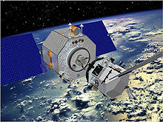
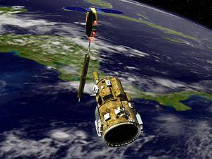
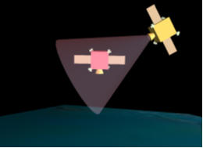
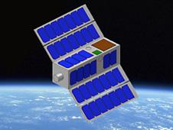
Mission Relevance
Orbital Express-
300 Million Dollars
DART-
95 Million Dollars
Previous RPO missions have come at a prohibitive cost.
Relates directly to NASA Strategic Goal 3.3.

Slide 5
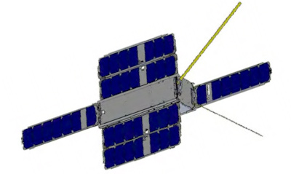
Mission Architecture
Fits within 6U CubeSat architecture (10x20x30cm).
One 3U (10x10x30cm) Primary/Interceptor Spacecraft
Providing a 1.5U payload.
Fits within Boeings Colony-II Bus
One 3U Secondary/Target Spacecraft
Will have a mission lifetime of 2 weeks
Designed to be as simple and easy to manage as possible
INSERT COOL SECONDARY SPACECRAFT ASSEMBLY

Slide 6


Orient for Separation
LV Separation and Checkout
Separation
Inspection Distance Checkout
Move to maximum relative separation
Launch
Stationkeep at maximum relative distance
Extended Ops and Deorbit
Repeat mission without visual aids
Inspection
Rendezvous

Slide 7
Functional Block Diagram
Primary Spacecraft
Secondary Spacecraft
Primary Aids
PLD
Flash Memory
PWR
Imager
CDH
Regulators
Batteries
Contact Switch
CDH
ADC
PRP
Microcontroller
Nutation Dampening
Thruster Block
Firing Circuit
COM
BRT
BRT
RFID Chip
Solenoid
Primary Attachment
Secondary Attachment
Power Pass
Boeing
Patch Rx Antenna
SSRL Ground Station

Slide 8
Mission Overview
Subsystem Overviews
Risk Overview

Slide 9
Secondary Attitude Determination and Control (ADC) Subsystem
The secondary spacecraft will utilize a nutation damping system capable of reducing slew rate to 10 ⁰/s within one orbit after separation.
INSERT COOL NUTATION DAMPING BUDGET

Slide 10
Primary ADC Subsystem
Responsible for developing control algorithms and for all orbit planning/analysis
Control algorithms and orbit analysis are defined relative to target spacecraft within CW Coordinate Frame

Slide 11
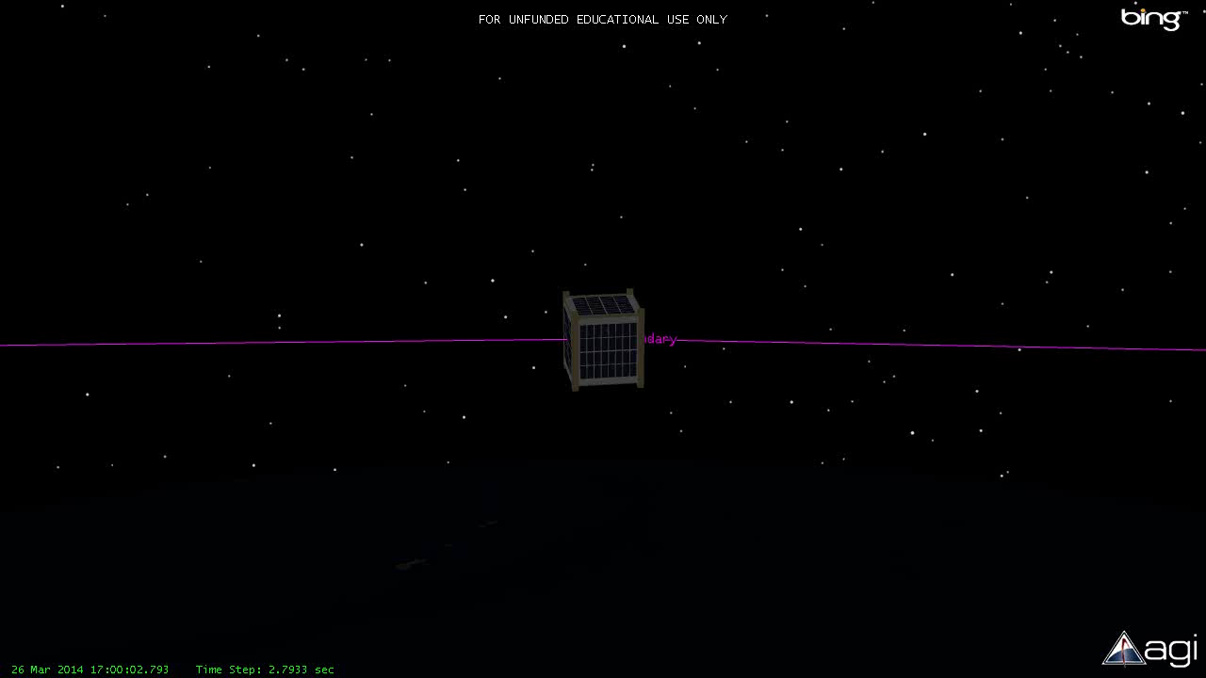

Slide 12
Delta-V Budget
Maneuver | ΔV for Each Perturbation Case (m/s)
 | 1 m | 5 m | 10 m | 100 m
Initial Separation | 0.5033 | 0.5134 | 0.5288 | 1.0791
ISK | 0.0067 | 0.0216 | 0.0432 | 0.4325
Continued Separation | 0.0151 | 0.0323 | 0.0538 | 0.4430
RSK | 0.0043 | 0.0216 | 0.0432 | 0.4325
Rendezvous | 0.0069 | 0.0116 | 0.0329 | 0.4220
Docking | 0.0084 | 0.0418 | 0.0837 | 0.8369
Total | 0.7903 | 1.3801 | 2.2593 | 18.3775
Margin | 98.1% | 97.2% | 95.5% | 63.2%

Slide 13
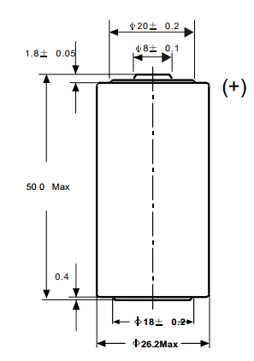
Secondary Power Subsystem
Secondary spacecraft has no power generation to reduce cost and complexity
Battery Voltage (V) | 3.6
Battery Current Rating (mA-hr) | 9000
Maximum Current Draw (mA) | 200
String Voltage (V) | 3.6
Number of Strings | 36
Total Battery Pack Current (mA-Hr) | 324000
Total Battery Pack Power (W-Hr) | 1166400
Total Orbits with LEDs On | 550.8
Total Days with LEDs On | 35.8
Required to last a minimum of 14 days for cooperative maneuvers
Largest continuous power draw comes from visual aid LEDs
Uses non-rechargeable lithium Thionyl Chloride C sized batteries for their high energy density

Slide 14
Propulsion Subsystem
The Rascal primary spacecraft will employ a cold-gas propulsion unit to conduct orbital maneuvers.
The propulsion subsystem provides 3-degrees-of-freedom translation capability through the use of six thruster pairs
The propulsion unit consists of two main subassemblies, the Tank Assembly and the Thruster Assembly, which are separated within the spacecraft for interface and integration purposes.
X+
Y+
X-
Y-
Tank Assembly
SLU Payload
Z+
Z-
Thruster Assembly
Z+
Boeing Colony-II Bus
Y+
Y-
X+
Z-
X+

Slide 15
Propulsion Subsystem
Main Tank
Tank Assembly
Expansion Valve
Expansion Chamber
Control valve
Thruster Valve
Thruster Assembly
Thruster Exit

Slide 16
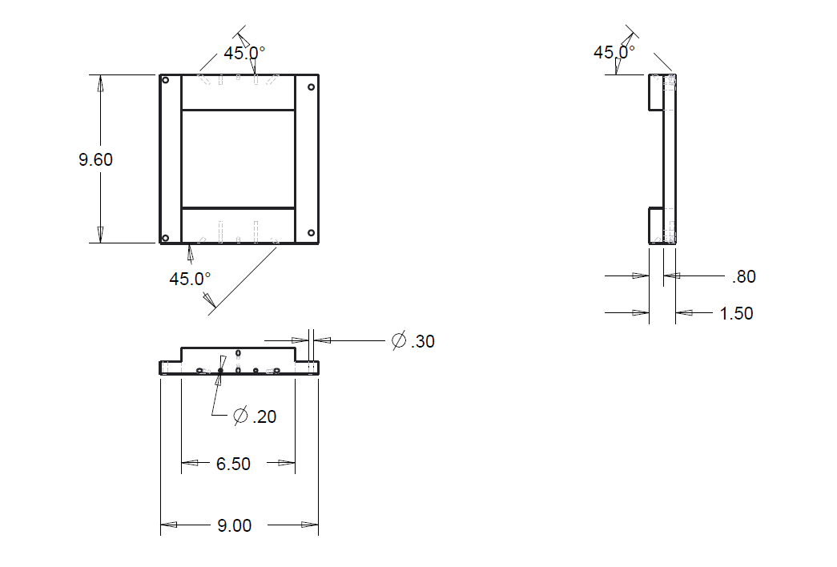
Propulsion Subsystem Thruster Assembly

Slide 17
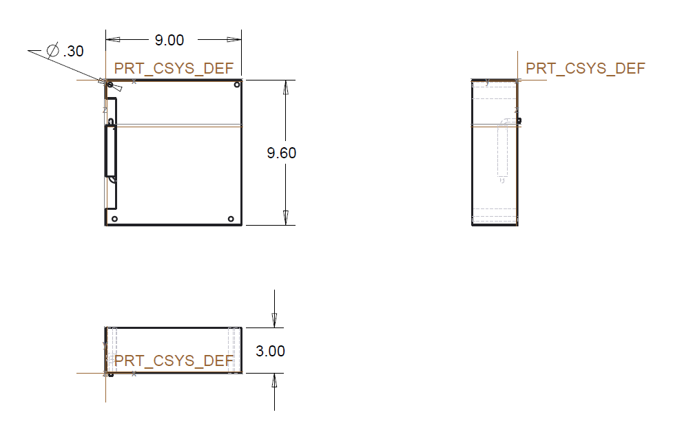
Propulsion Subsystem Tank Assembly

Slide 18
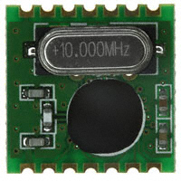
Communication Subsystem
The primary spacecraft will use the communications system made available on the Colony-II bus
The secondary spacecraft communication system will be developed at SLU
Only needs to receive
(per mission requirements)
Consists of an RFID chip and UHF patch antenna

Slide 19
Link Budget
Assumptions: 300 km circular orbit, 5° above horizon
 | Units | Values | Comments & References
Uplink Frequency | MHz | 433 | UHF Uplink
Station TX power | dB | 16.9897
Gain | dBi | 15
Ground Station Losses | dB | 3.6 | Internal Loss on the transmission lines
EIRP | dBW | 28.3897
Pointing Loss | dB | 0.2
Polarization Loss | dB | 0.2
Atmospheric Loss | dB | 2.1
Ionospheric Loss | dB | 0.4
Propagation Range | km | 1500
Path Loss | dB | 148.71
Isotropic Signal @ S/C | dBW | -123.22
G/T | dB-K | -21.17
S/N₀ | dBHz | 84.01
Data Rate, B | dB | 36.02
E_{b}/N₀ | dB | 47.99
Bit Rate Error |  | 0.0000

Slide 20
Data Budget
30 fps camera
640x480 resolution
24 bit color
16 GB of storage

Slide 21
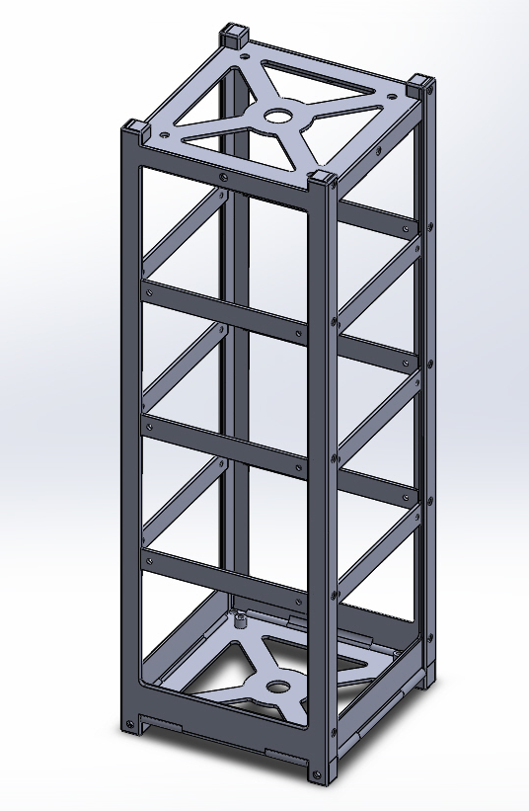
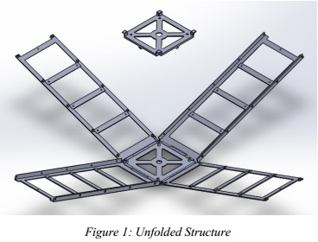
Structures Subsystem
Secondary spacecraft’s structure and separation system will be developed in house.

Slide 22
Secondary Structure Mass Budget
SSRL Secondary Spacecraft
Subsystem | Item | Individual Mass (g) | Lower Bound (g) | Upper Bound (g) | Quantity | Total Lower Bound (g) | Total Upper Bound (g) | Total Mass (g)
Structures | SSRL 3U Structure (6061 T6 Aluminum) | 314 | 313 | 315 | 1 | 313 | 315 | 314
 | Threaded Rod | 11.16 | 11.07 | 11.25 | 4 | 44.28 | 45 | 44.64
 | SSRL Battery Holder | 479.0468 | 478 | 485 | 1 | 478 | 485 | 479.0468
 | Screws for 3U Structure (M3x.5mm, 6 mm long) | 1.52 | 1.512 | 1.53 | 64 | 96.768 | 97.6 | 97.28
 | Solenoid | 23.5 | 23.48 | 23.53 | 2 | 46.96 | 47.06 | 47
 | Wire Harnesses for Battery Pack to EPS | 0.68 | 0.67 | 7 | 18 | 12.06 | 126 | 12.24
 | Wire Harness for Battery Pack between batteries | 0.2 | 0.18 | 0.22 | 45 | 8.1 | 9.9 | 9
 | 6.4mm spacer (inner diameter 3.34 mm, outer 6mm) | 0.9088 | 0.896 | 0.9216 | 4 | 3.584 | 3.6864 | 3.6352
 | Solenoid Support Structures | 11.25 | 11 | 11.5 | 2 | 22 | 23 | 22.5
Communications, Power, CDH | Patch Antenna | 1.5 | 1.4 | 1.6 | 1 | 1.4 | 1.6 | 1.5
 | Energizer L91 AA Battery | 14.5 | 14.25 | 14.75 | 54 | 769.5 | 796.5 | 783
 | Custom Comm Board for EPS, CDH, COMMs (FM Receiver Module - 433 MHz, microprocessor, CDH processor) | 29.8 | 29.5 | 35 | 1 | 29.5 | 35 | 29.8
 | Additional Components | 15 | 10 | 20 | 1 | 10 | 20 | 15
Payload | Surface Mount LED lights | 0 | 0 | 0 | 20 | 0 | 0 | 0
 | PCB Boards | 80.51 | 80.46 | 80.565 | 4 | 321.84 | 322.26 | 322.04
ADC | Nutation Damping System |  |  |  |  | 0 | 0 | 0
Total |  |  |  |  |  | 2157 | 2328 | 2181

Slide 23
Mass Budget cont’d
Remaining Mass for ADC
Total Allotted Mass (g) | 4000
Current Estimated Mass Used W/O ADC (g) | 2181
Total Mass Alloted for Glue and Kapton (g) | 100
Total Mass Alloted for Unforseen Circumstances (g) | 200
Mass Allotted for ADC (g) | 1519
The ADC subsystem is allotted about 1.5 kg to develop the nutation damping system that will meet mission requirements.

Slide 24
Separation
Interface Plate
The mission requires two independent 3U spacecrafts that integrate into a single 6U bus.
Separation of the two spacecrafts is necessary for mission success.
Testing has commenced on the effectiveness of using solenoids for the separation system.
Structural Support
Separation Port
Spring
Solenoid
Powering System
Structural Support

Slide 26
Mission Overview
Subsystem Overviews
Risk Overview

Slide 27
Risk Criteria
Levels of Likelihood
Levels of Consequences
Level | Likelihood | Possibility of Occurrence
1 | Not Likely | ~10%
2 | Low Likelihood | ~30%
3 | Likely | ~50%
4 | Highly Likely | ~70%
5 | Near Certainty | ~90%
Level | Associated Risk
1 | Minimal or no consequences to technical performance
2 | Minor reduction in technical performance or supportability, can be tolerated with little to no impact on mission
3 | Modest reduction in technical performance or supportability with limited impact on mission objectives
4 | Significant degradation in technical performance or major shortfall in supportability; may jeopardize mission success
5 | Sever degradation in technical performance, failure to meet mission objectives, will jeopardize mission success
Risk Reporting Matrix
Likelihood | 1
 | 2
 | 3
 | 4
 | 5
 |  | 1 | 2 | 3 | 4 | 5
 |  | Consequences

Slide 28
Mission Risks
Spacecraft unable to separate
Collision during inspection stationkeeping
Unable to rendezvous during cooperative maneuvers
Unable to rendezvous during non-cooperative maneuvers
Collision during rendezvous
Likelihood | 1
 | 2
 | 3
 | 4 |  |  |  | 2, 3, 4 | 5
 | 5 |  |  |  |  | 1
 |  | 1 | 2 | 3 | 4 | 5
 |  | Consequences

Slide 29
QUESTIONS?

